Slide 1
Transcriptomic Exam Roberto Amarie ID:11297A

Slide 2
Bulk RNAseq analysis

Slide 3
Quality Control
BRAIN:
11, RIN:6.7 %rRNA: 0.065 %map: 89
12, RIN:7.5 %rRNA: 0.015 %map: 91.3
13 RIN:7.1 %rRNA: 0.053 %map: 89.8
SPLEEN:
11, RIN:6.7 %rRNA: 0.005 %map: 88.3
12, RIN:8.3 %rRNA: 0.005 %map: 89
13 RIN:7.1 %rRNA: 0.005 %map: 89.4
KIDNEY:
11 RIN:6.2 %rRNA: 0.018 %map: 88.2
17 RIN:7.8 %rRNA: 0.009 %map: 88.9
18 RIN:7.5 %rRNA: 0.028 %map: 92.3
12-16 were discarded for low RINs (5.5 5.6 5.6 5.8 5.9)
Notes:
RIN:
usually recommend at least 7, but 6 or higher is usually considered to be “acceptable”.
%rRNA:
should be very low, never anyway higher than 10% (or 0.1 since here is the fraction to be reported)
%uniquely_mapped:
We want here at least 85% of the reads uniquely mapped, since it is a human sample

Slide 4
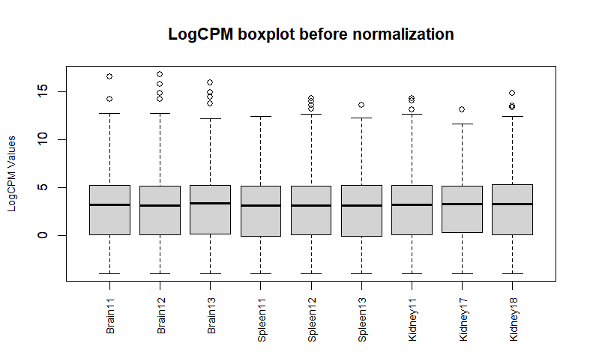

TMM Normalization
Sample | Norm fact
Brain11 | 0.8996035
Brain12 | 0.8198675
Brain13 | 0.9565529
Sample | Norm fact
Spleen11 | 1.1098109
Spleen12 | 1.0577364
Spleen13 | 1.0873171
Sample | Norm fact
Kidney11 | 0.9672291
Kidney17 | 1.1316299
Kidney18 | 1.0145647

Slide 5
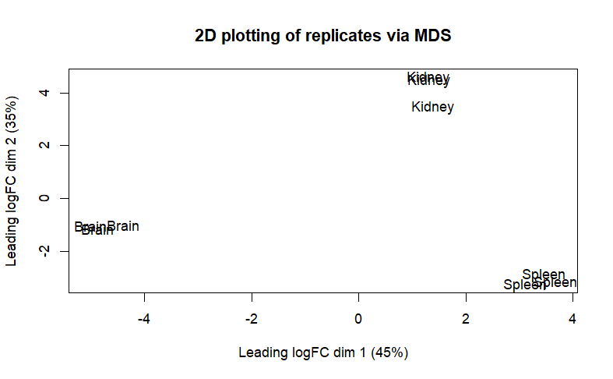
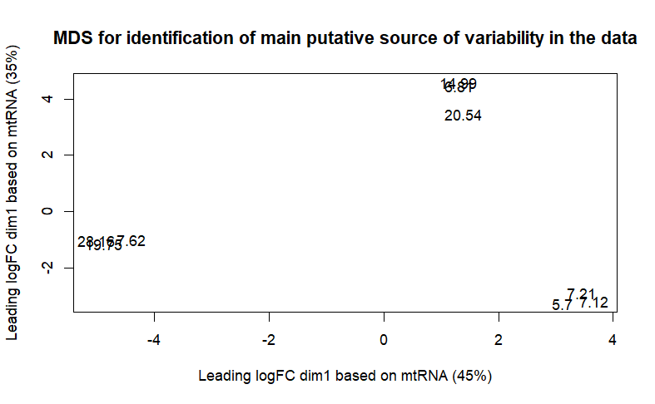
MDS projection

Slide 6
DE genes
Number of genes up/down regulated in each comparison:
-1* Brain | 1*Kidney
Up (Kidney) | 2339
NotSig | 19927
Down(Brain) | 2220
-1* Brain | 1* Spleen
Up (Spleen) | 3602
NotSig | 17990
Down(Brain) | 2894
-1*Kidney | 1*Spleen
Up(Spleen) | 2169
NotSig | 21138
Down(Kidney) | 1179
Resulting tissue-specific list of upregulated genes:
Filtering applied:
FDR<0.01
logCPM>0
 | Vs Others
Brain | 274
Spleen | 147
Kidney | 217
Gene list ordered by increasing FDR

Slide 7
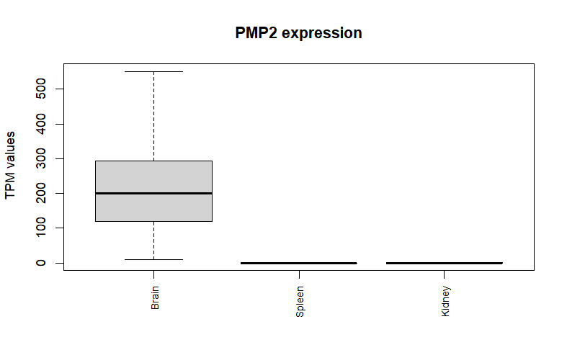
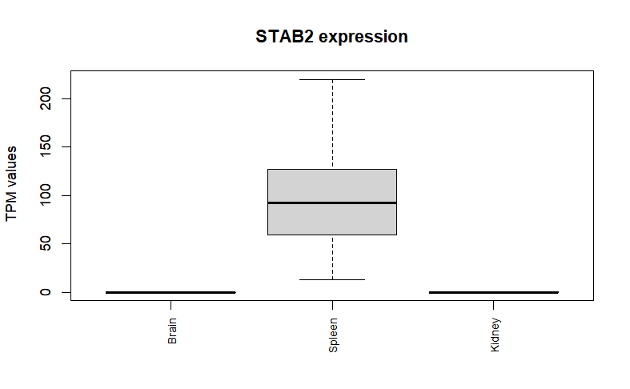
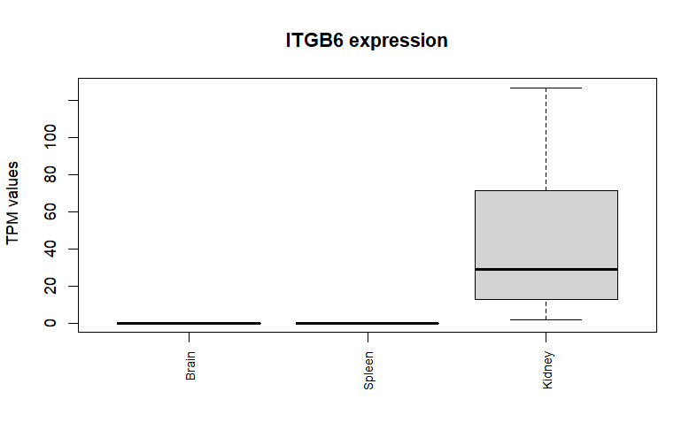
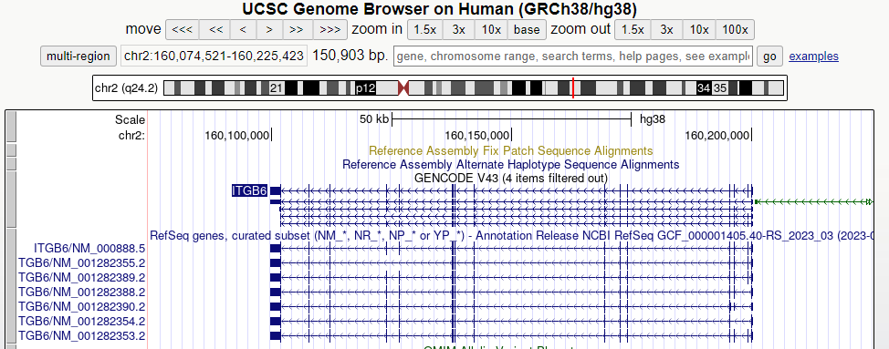
Over expressed tissue-specific gene
Notes:
STAB2:
This gene encodes a large, transmembrane receptor protein which may function in angiogenesis, lymphocyte homing, cell adhesion, or receptor scavenging. The protein contains 7 fasciclin, 15 epidermal growth factor (EGF)-like, and 2 laminin-type EGF-like domains as well as a C-type lectin-like hyaluronan-binding Link module. The protein is primarily expressed on liver sinusoidal endothelial cells, spleen, and lymph node. The receptor has been shown to bind and endocytose ligands such as hyaluronan, low density lipoprotein, Gram-positive and Gram-negative bacteria, and advanced glycosylation end products. Supporting its possible role as a scavenger receptor, the protein has been shown to cycle between the plasma membrane and lysosomes.[

Slide 8
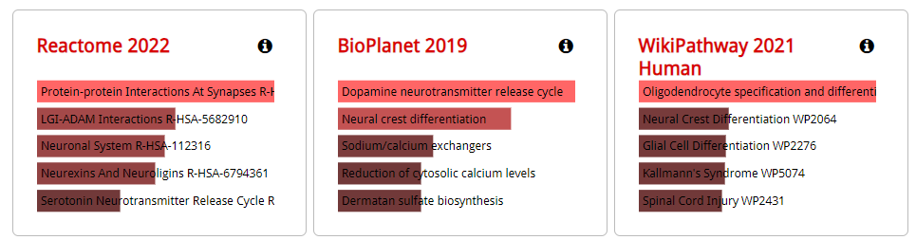
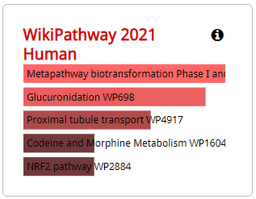
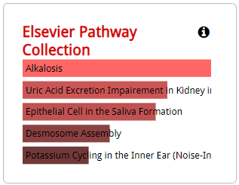

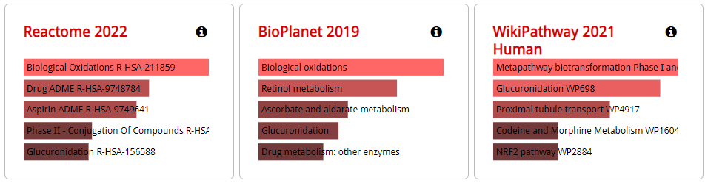
Functional Enrichment Analysis
BRAIN:
SPLEEN:
SPLEEN:

Slide 9
scRNAseq analysis

Slide 10
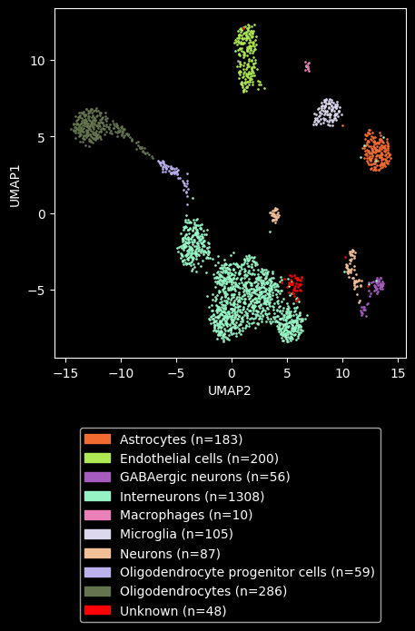
Reference Material
PRJNA438862 SRA667466 Zeisel A et al., "Molecular Architecture of the Mouse Nervous System.", Cell, 2018 Aug 9;174(4):999-1014.e22
Mus musculus 10x chromium
They analyzed 19 brain regions, using at least two mice for each tissue, typically one male and one female, resulting in analyzing a total of 133 samples to reveal the transcriptomes of 509,876 cells.
The final, high-quality curated compendium comprised 265 clusters represented by 160,796 high-quality single-cell transcriptomes
My Panglao subset was instead limited to the neocortex with initially 20844 features across 5744 samples upon selection of samples with at least 200 features and minimum of 3 cells

Slide 11
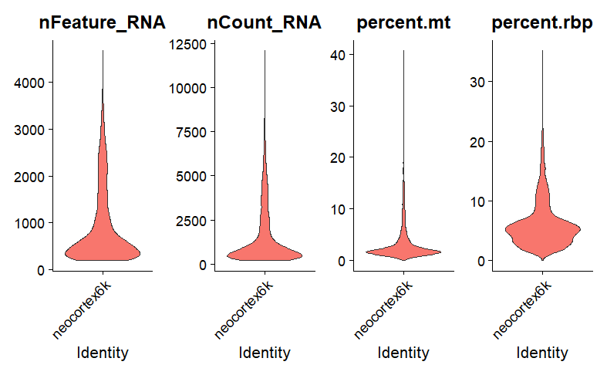
Quality control
Criteria
200 < nFeature_RNA < 4000
percent.mt < 10
Outputs
5745 samples -> 5285 samples (460 samples discarded)
Notes:
Hilscher, M.M., Langseth, C.M., Kukanja, P. et al. Spatial and temporal heterogeneity in the lineage progression of fine oligodendrocyte subtypes. BMC Biol 20, 122 (2022). https://doi.org/10.1186/s12915-022-01325-z
The OL lineage presents itself as a continuum of oligodendrocyte precursor cells (OPCs), committed OPCs (COPs), newly formed OLs (NFOLs), myelin-forming OLs (MFOLs), and mature OLs (MOLs)

Slide 12
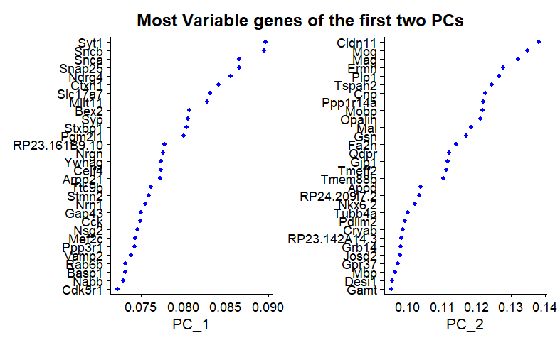
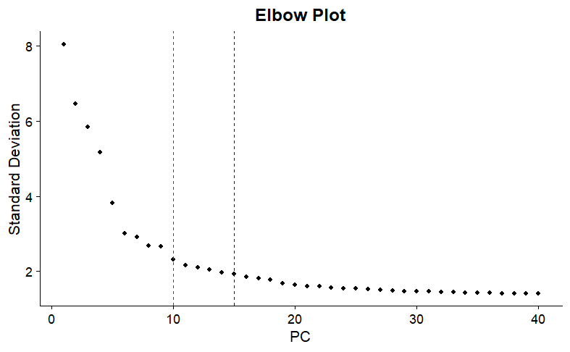
Dimensionality Reduction via PCA

Slide 13
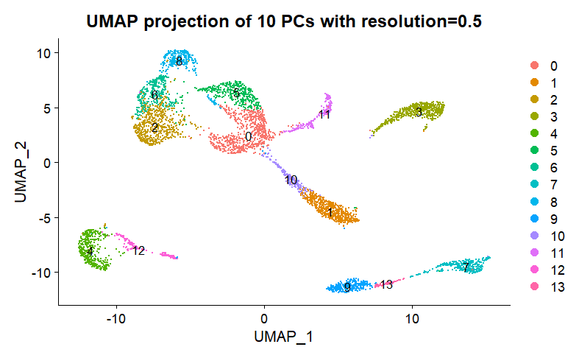
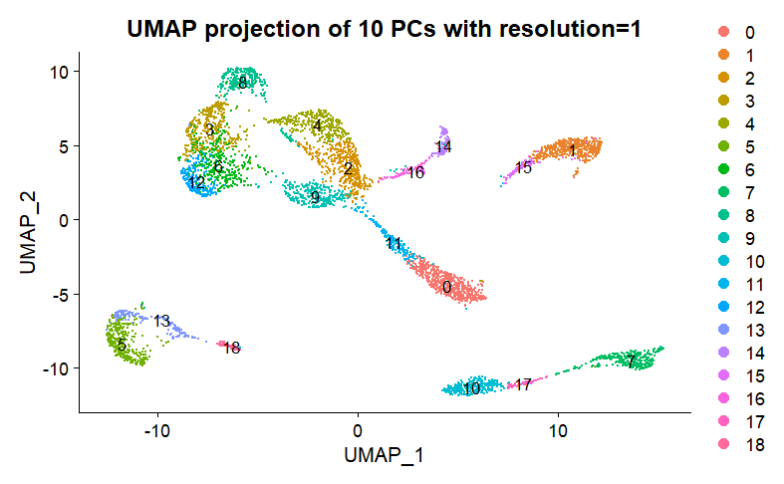
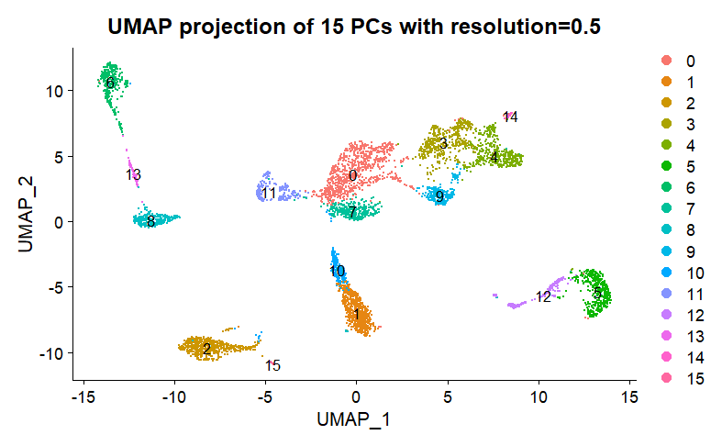
Candidate clusters

Slide 14
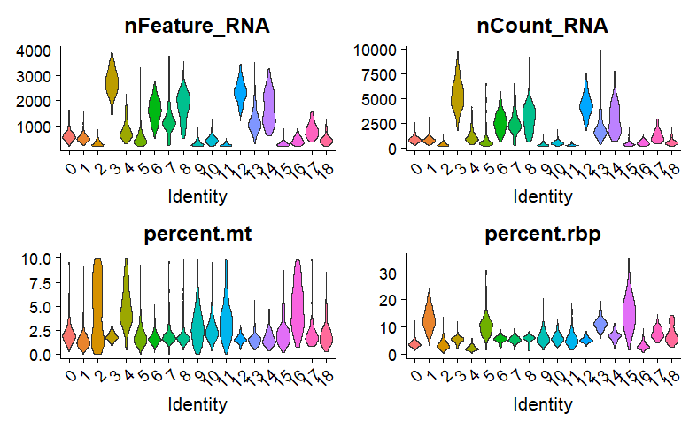
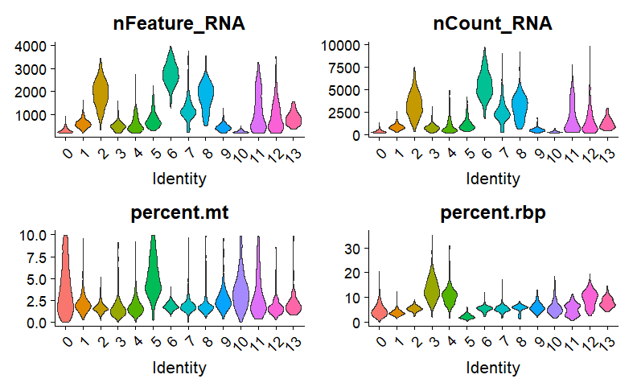
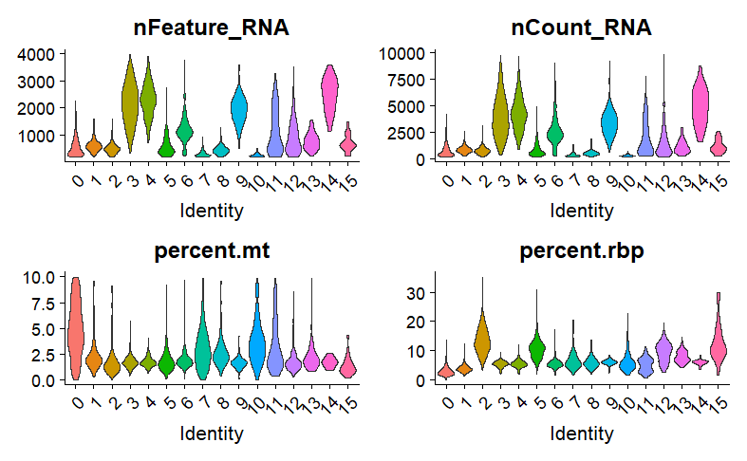
Candidate clusters

Slide 15
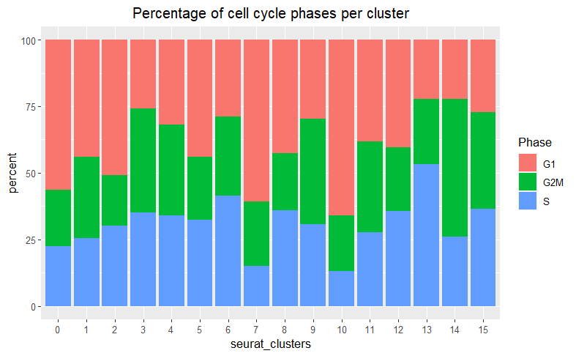
Chosen Cluster
Cluster | 0 | 1 | 2 | 3 | 4 | 5 | 6 | 7 | 8 | 9 | 10 | 11 | 12 | 13 | 14 | 15
Number of cells | 847 | 613 | 551 | 469 | 457 | 419 | 334 | 315 | 282 | 266 | 215 | 210 | 168 | 90 | 27 | 22

Slide 16
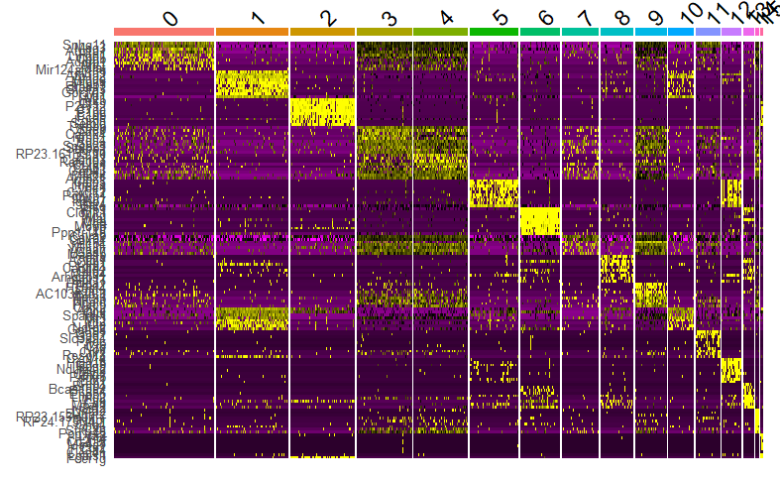
1vsAll contrast for marker genes identification

Slide 17
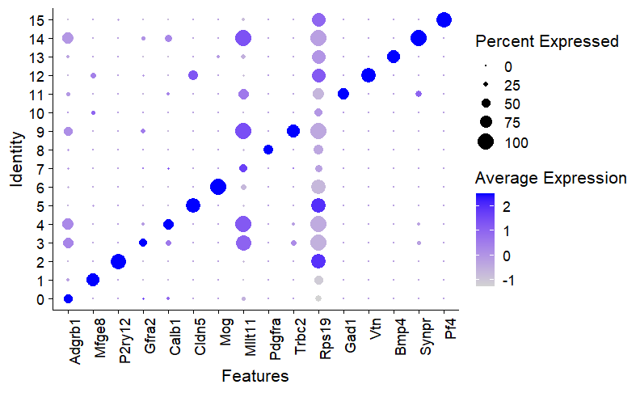
Dotplot of Marker genes

Slide 18
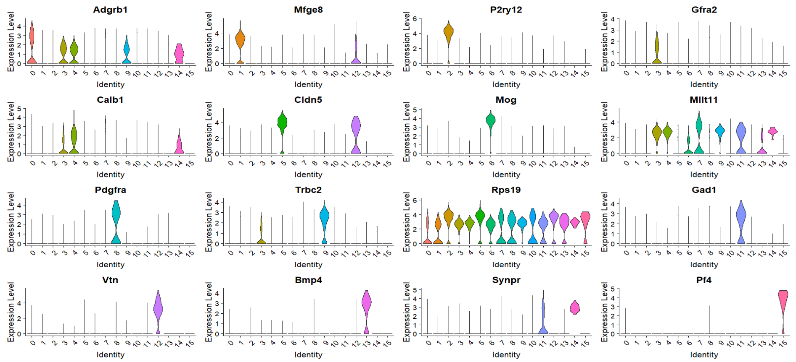
ViolinPlot of Marker genes

Slide 19
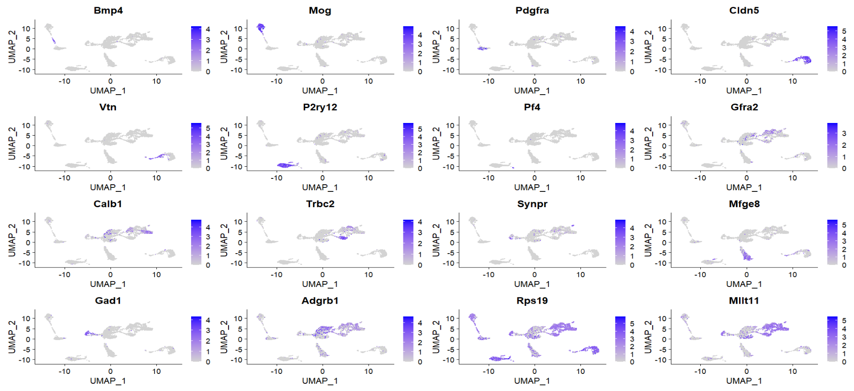
FeaturePlot of marker genes

Slide 20
